Slide 2
Communication
Verbal
Para-verbal
Non-verbal
Words (What we say)
Tone of voice (How we say it)
Body language
(How we act)
???
Notes:
Abholen: Mc Donalds verliert Marktanteile >> Fast Casual Restaurants als Gewinner

Slide 3
Communication
Verbal
7%
Non-verbal
55%
Para-verbal
38%

Slide 4
Communication
Non-verbal
Facial expression & Eye contact
Gestures
Postures
Appearance
Verbal
Para-verbal
Tone of voice

Slide 5
Communication
Non-verbal
Facial expression & Eye contact
Gestures
Postures
Appearance
Verbal
Para-verbal
Tone of voice

Slide 6
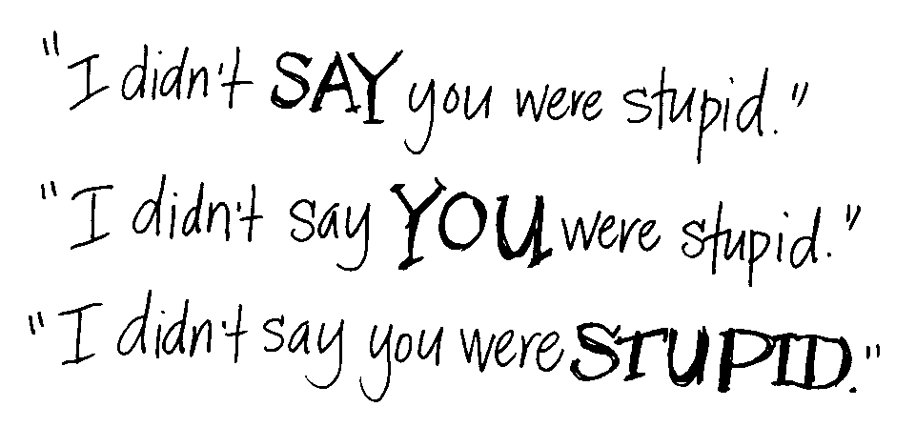
Para-verbal communication
→ What you think you say is not always what you actually say!

Slide 7
Para-verbal communication
ANGRY AND EXCITED
rapid speech,higher pitched
BORED OR FEELING DOWN
slow monotone speech
FEELING DEFENSIVE
abrupt
→ How we feel influences our pitch

Slide 8
Communication
Non-verbal
Facial expression & Eye contact
Gestures
Postures
Appearance
Verbal
Para-verbal
Tone of voice

Slide 9
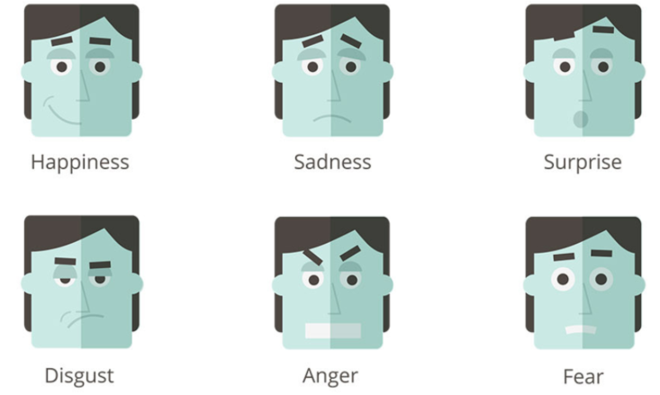
Non-verbal communication
Facial expression & Eye contact
→ It's not so difficult to know how someone feels.

Slide 10
Communication
Non-verbal
Facial expression & Eye contact
Gestures
Postures
Appearance
Verbal
Para-verbal
Tone of voice

Slide 11

Non-verbal communication
Gestures
http://www.ncp-incontact.eu/nkswiki/images/6/67/Intercultural_Business_Etiquette_PPT_v1.pdf
→ Inform yourself about people‘s practices when you travel

Slide 12
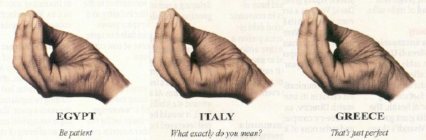
Non-verbal communication
Gestures
→ Be aware: Gestures can have different meanings in different countries!

Slide 13
Communication
Non-verbal
Facial expression & Eye contact
Gestures
Postures
Appearance
Verbal
Para-verbal
Tone of voice

Slide 14
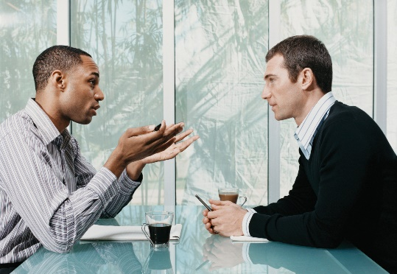
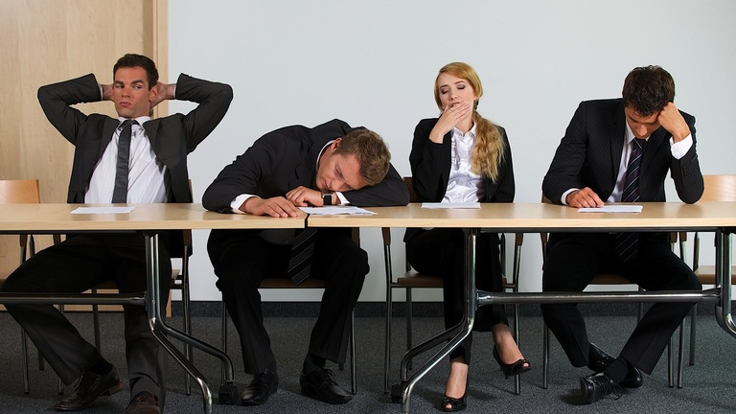


Non-verbal communication
Posture
→ You carry a message the way you are sitting or standing!

Slide 15

Non-verbal communication
Posture
Receptive
Upright posture
Facing a person when you speak or listen
Disrespectful
Slouching
Looking the other way, staring at the ceiling
→ Paying attention is the basis of communication!

Slide 16
Communication
Non-verbal
Facial expression & Eye contact
Gestures
Postures
Appearance
Verbal
Para-verbal
Tone of voice

Slide 17


Non-verbal communication
Appearance
→ How self-confident we seem to be…

Slide 18
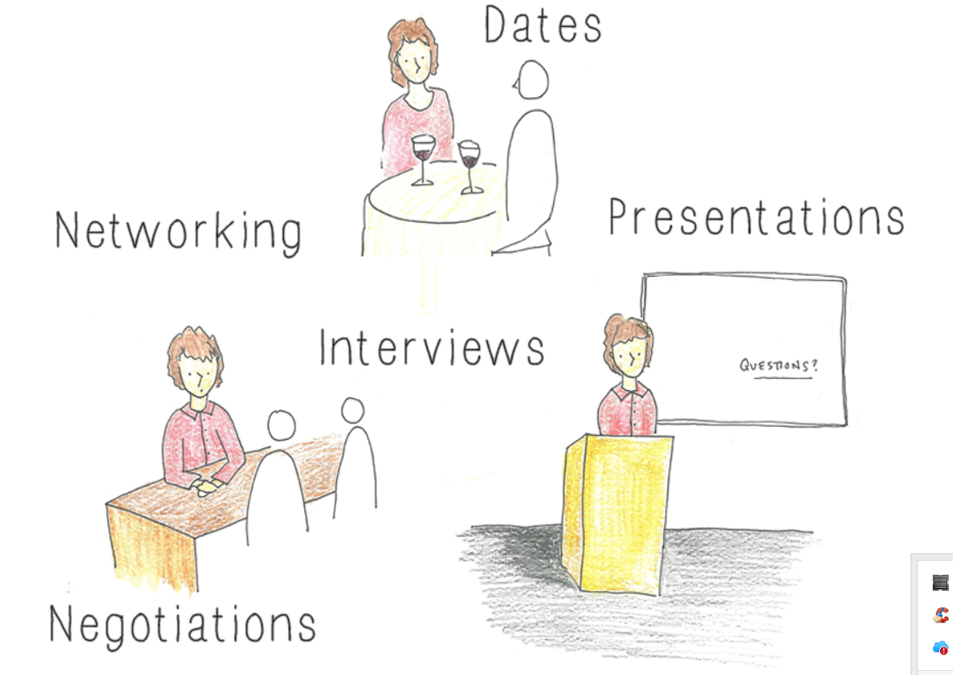
Non-verbal communication
Appearance
→ … is important in many situations!

Slide 19
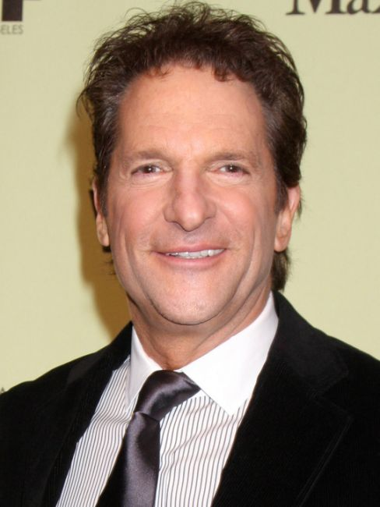

Non-verbal communication
Appearance
“Language is a more recent technology. Your body language, your eyes, your energy will come through to your audience before you even start speaking.”
Peter Guber
American film-director
→ It takes 7 seconds, to make a judgement about a person

Slide 20
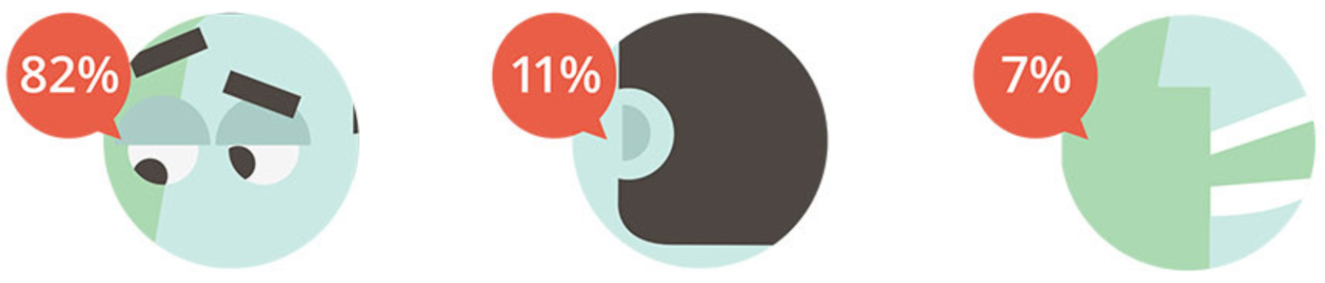
Non-verbal communication
Appearance
Eyes
Ears
Other senses
→ We take most of the world around us by our eyes!

Slide 21

Non-verbal communication
Appearance
→ Intercultural expression of victory!!

Slide 22
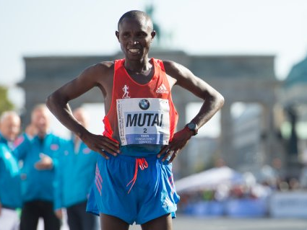
Non-verbal communication
Appearance
→ Intercultural expression of power!!

Slide 23
Non-verbal communication
Appearance
20%
Increase of testosterone
→ Confidence and motivation
2 min
POWER POSES
25%
Decrease of cortisol
→ Stress hormone
→ Boost yourself with power poses!

Slide 24
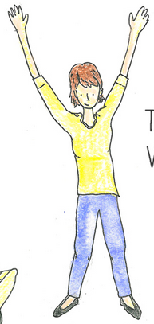
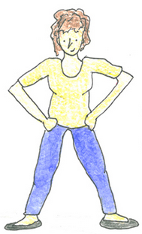
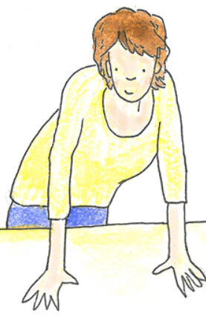
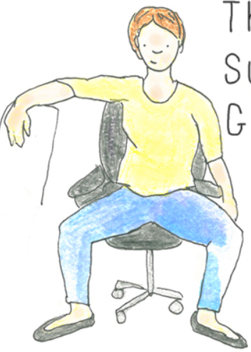
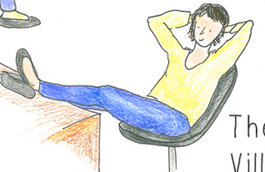
Non-verbal communication
Appearance
Wonder Woman
Marathon Champion
Sitting posture of the Boss
Ready to start
Subway Guy
→ “Fake it until you become it!” (Amy Cuddy)

Slide 25


Non-verbal communication
Appearance
2 min
Privacy (optional)
Just you
→ What you need: Materials & Instructions

Slide 26
Communication
Verbal
7%
Non-verbal
55%
Para-verbal
38%

Slide 27
Take-home messages
1
Be aware of the importance of non- and para-verbal communication
Verbal
7%
Non-verbal
55%
Para-verbal
38%

Slide 28
Take-home messages
1
Be aware of the importance of non- and para-verbal communication
2
People will judge you within the first 7 seconds

Slide 29

Take-home messages
1
Be aware of the importance of non- and para-verbal communication
2
People will judge you within the first 7 seconds
3
Make power poses before important situations and “fake it until you become it!!”

Slide 31
Sources
http://www.skillsyouneed.com/general/what-is-communication.html
https://tylerbeardshow.wordpress.com/2015/09/01/verbal-and-non-verbal-communication/
http://www.livestrong.com/article/128321-nonverbal-communication/
https://alexrister1.files.wordpress.com/2013/12/getting-ahead-in-business-with-body-language_529e3d21757401.jpg
https://alexrister1.wordpress.com/tag/nonverbal-communication-2/
http://de.slideshare.net/ethos3/the-importance-of-nonverbal
http://blog.gengo.com/body-language-infographic/
http://smallanswers.us/two-minutes-in-the-closet-power-poses-2/
http://www.ted.com/talks/amy_cuddy_your_body_language_shapes_who_you_are
http://www.karmayourself.de/power-posing-selbstbewusstesein-staerken-durch-koerperhaltung/
http://www.ncp-incontact.eu/nkswiki/images/6/67/Intercultural_Business_Etiquette_PPT_v1.pdf

